Slide 1
GIS Data Structures
From the 2-D Map to 1-D Computer Files

Slide 2
Representing Geographic Features: review from opening lecture
How do we describe geographical features?
by recognizing two types of data:
  Spatial data which describes location (where)
  Attribute data which specifies characteristics at that location
  (what, how much, and when)
How do we represent these digitally in a GIS?
by grouping into layers based on similar characteristics (e.g hydrography, elevation, water lines, sewer lines, grocery sales) and using either:
  vector data model (coverage in ARC/INFO, shapefile in ArcView)
  raster data model (GRID or Image in ARC/INFO & ArcView)
by selecting appropriate data properties for each layer with respect to:
  projection, scale, accuracy, and resolution
How do we incorporate into a computer application system?
by using a relational Data Base Management System (DBMS)
We introduced these concepts in the opening lecture. We will deal with them in more detail tonight (except for data properties which will be dealt with under Data Quality).

Slide 3
GIS Data Structures: Topics Overview
Spatial data types and Attribute data types
Relational database management systems (RDBMS): basic concepts
        DBMS and Tables
        Relational DBMS
raster data structures: represents geography via grid cells
  tesselations
  run length compression
  quad tree representation
  BSQ/BIP/BIL
  DBMS representation
  File formats
vector data structures:
represents geography via coordinates
  whole polygon
  point and polygon
  node/arc/polygon
  Tins
  File formats
    Overview: representation of surfaces

Slide 4
Spatial Data Types
continuous: elevation, rainfall, ocean salinity
areas:
  unbounded: landuse, market areas, soils, rock type
  bounded: city/county/state boundaries, ownership parcels, zoning
  moving: air masses, animal herds, schools of fish
networks: roads, transmission lines, streams
points:
  fixed: wells, street lamps, addresses
  moving: cars, fish, deer

Slide 5
Attribute data types
Categorical (name):
  nominal
    no inherent ordering
    land use types, county names
  ordinal
    inherent order
    road class; stream class
often coded to numbers eg SSN but can’t do arithmetic
Numerical
    Known difference between values
  interval
    No natural zero
    can’t say ‘twice as much’
    temperature (Celsius or Fahrenheit)
  ratio
    natural zero
    ratios make sense (e.g. twice as much)
    income, age, rainfall
may be expressed as integer [whole number] or floating point [decimal fraction]
Attribute data tables can contain locational information, such as addresses
or a list of X,Y coordinates. ArcView refers to these as event tables. However,
these must be converted to true spatial data (shape file), for example by
geocoding, before they can be displayed as a map.

Slide 6
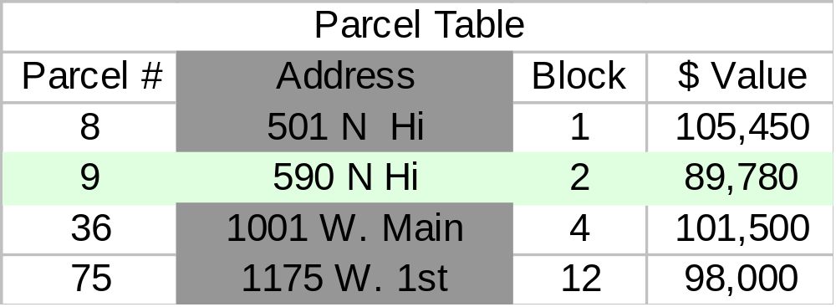
Data Base Management Systems (DBMS)
entity
Key field
Attribute
Contain Tables or feature classes in which:
  rows: entities, records, observations, features:
    ‘all’ information about one occurrence of a feature
  columns: attributes, fields, data elements, variables, items (ArcInfo)
    one type of information for all features
The key field is an attribute whose values uniquely identify each row

Slide 7
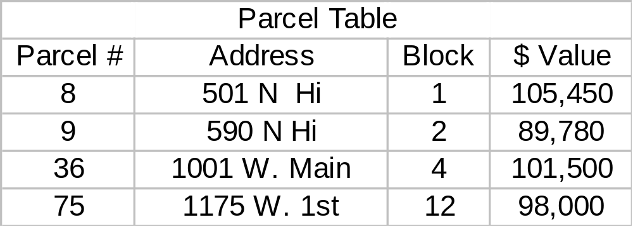
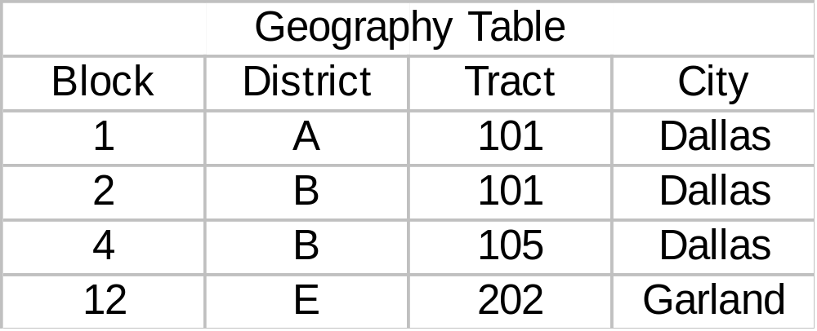
Relational DBMS:
Tables are related, or joined, using a common record identifier (column variable), present in both tables, called a secondary (or foreign) key, which may or may not be the same as the key field.
Goal: produce map
of values by district/
neighborhood
Problem: no district
code available in Parcel
Table
Secondary or foreign key
Solution: join Parcel Table,
containing values, with
Geograpahy Table, containing
location codings, using Block
as key field

Slide 8
GIS Data Models:
Raster v. Vector
“raster is faster but vector is corrector” Joseph Berry
Raster data model
  location is referenced by a grid cell in a rectangular array (matrix)
  attribute is represented as a single value for that cell
  much data comes in this form
    images from remote sensing (LANDSAT, SPOT)
    scanned maps
    elevation data from USGS
  best for continuous features:
    elevation
    temperature
    soil type
    land use
Vector data model
  location referenced by x,y coordinates, which can be linked to form lines and polygons
  attributes referenced through unique ID number to tables
  much data comes in this form
    DIME and TIGER files from US Census
    DLG from USGS for streams, roads, etc
    census data (tabular)
  best for features with discrete boundaries
    property lines
    political boundaries
    transportation

Slide 9
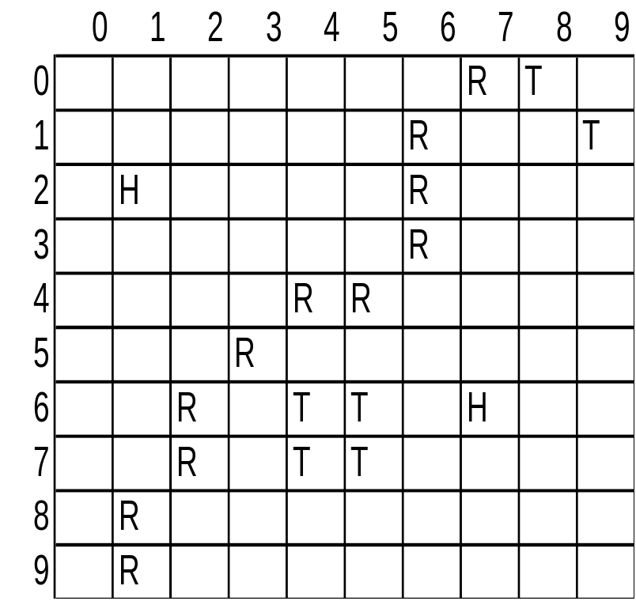
Concept of
Vector and Raster
Real World
Raster Representation
Vector Representation
point
line
polygon

Slide 10
Representing Data using Raster Model
area is covered by grid with (usually) equal-sized cells
location of each cell calculated from origin of grid:
  “two down, three over”
cells often called pixels (picture elements); raster data often called image data
attributes are recorded by assigning each cell a single value based on the majority feature (attribute) in the cell, such as land use type.
easy to do overlays/analyses, just by ‘combining’ corresponding cell values: “yield= rainfall + fertilizer” (why raster is faster, at least for some things)
simple data structure:
  directly store each layer as a single table
  (basically, each is analagous to a “spreadsheet”)
  computer data base management system not required (although many raster GIS systems incorporate them)
corn
fruit
oats
wheat
clover
fruit
0
1
2
3
4
5
6
7
8
9
0
1
1
1
1
1
4
4
5
5
5
1
1
1
1
1
1
4
4
5
5
5
2
1
1
1
1
1
4
4
5
5
5
3
1
1
1
1
1
4
4
5
5
5
4
1
1
1
1
1
4
4
5
5
5
5
2
2
2
2
2
2
2
3
3
3
6
2
2
2
2
2
2
2
3
3
3
7
2
2
2
2
2
2
2
3
3
3
8
2
2
4
4
2
2
2
3
3
3
9
2
2
4
4
2
2
2
3
3
3

Slide 11
Raster Data Structures: Concepts
grid often has its origin in the upper left but note:
  State Plane and UTM, lower left
  lat/long & cartesian, center
single values associated with each cell
  typically 8 bits assigned to values therefore 256 possible values (0-255)
rules needed to assign value to cell if object does not cover entire cell
  majority of the area (for continuous coverage feature)
  value at cell center
  ‘touches’ cell (for linear feature such as road)
  weighting to ensure rare features represented
choose raster cell size 1/2 the length (1/4 the area) of smallest feature to map (smallest feature called minimum mapping unit or resel--resolution element)
raster orientation: angle between true north and direction defined by raster columns
class: set of cells with same value (e.g. type=sandy soil)
zone: set of contiguous cells with same value
neighborhood: set of cells adjacent to a target cell in some systematic manner

Slide 12
Raster Data Structures: Tesselations
(Geometrical arrangements that completely cover a surface.)
Square grid: equal length sides
  conceptually simplest
  cells can be recursively divided into cells of same shape
  4-connected neighborhood (above, below, left, right) (rook’s case)
    all neighboring cells are equidistant
  8-connected neighborhood (also include diagonals) (queen’s case)
    all neighboring cells not equidistant
    center of cells on diagonal is 1.41 units away (square root of 2)
rectangular
  commonly occurs for lat/long when projected
  data collected at 1degree by 1 degree will be varying sized rectangles
triangular (3-sided) and hexagonal (6-sided)
  all adjacent cells and points are equidistant
triangulated irregular network (tin):
  vector model used to represent continuous surfaces (elevation)
  more later under vector

Slide 13
Raster Data Structures
Runlength Compression (for single layer)
Full Matrix--162 bytes
Run Length (row)--44 bytes
111111122222222223
111111122222222233
111111122222222333
111111222222223333
111113333333333333
111113333333333333
111113333333333333
111333333333333333
111333333333333333
1,7,2,17,3,18
1,7,2,16,3,18
1,7,2,15,3,18
1,6,2,14,3,18
1,5,3,18
1,5,3,18
1,5,3,18
1,3,3,18
1,3,3,18
This is a “lossless” compression, as opposed to “lossy,” since the original data can be exactly reproduced.
Now, GIS packages generally rely on commercial compression routines. Pkzip is the most common, general purpose routine. MrSid (from Lizard Technology)and ECW (from ER Mapper) are used for images. All these essentially use the same concept. Occasionally, data is still delivered to you in run-length compression, especially in remote sensing applications.
“Value thru column” coding.
1st number is value, 2nd is
last column with that value.

Slide 14
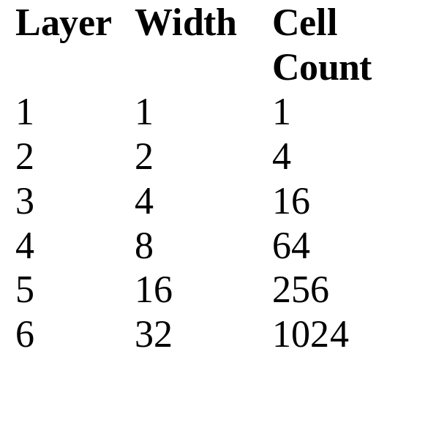
Raster Data Structures
Quad Tree Representation (for single layer)
Essentially involves compression applied to both row and column.
sides of square grid divided evenly on a recursive basis
  length decreases by half
  # of areas increases fourfold
  area decreases by one fourth
Resample by combining (e.g. average) the four cell values
  although storage increases if save all samples, can save processing costs if some operations don’t need high resolution
for nominal or binary data can save storage by using maximum block representation
  all blocks with same value at any one level in tree can be stored as single value
3.25
3
4
3.5
2.5
2
4
5
3
4
2
4
4
4
4
1
4
2
4
3
2
store this quadrant
as single 1
1
1
1
1
1
1
1
store this quadrant
as single zero
1
I 1,0,1,1 II 1
III 0,0,0,1 IV 0

Slide 15
Raster Data Structures:
Raster Array Representations for multiple layers
raster data comprises rows and columns, by one or more characteristics or arrays
  elevation, rainfall, & temperature; or multiple spectral channels (bands) for remote sensed data
  how organise into a one dimensional data stream for computer storage & processing?
Band Sequential (BSQ)
  each characteristic in a separate file
  elevation file, temperature file, etc.
  good for compression
  good if focus on one characteristic
  bad if focus on one area
Band Interleaved by Pixel (BIP)
  all measurements for a pixel grouped together
  good if focus on multiple characteristics of geographical area
  bad if want to remove or add a layer
Band Interleaved by Line (BIL)
  rows follow each other for each characteristic
B B
Veg
A B
Soil
III IV
I II
150 160
120 140
Elevation
Note that we start in lower left.
Upper left is alternative.
File 1: Veg A,B,B,B
File 2: Soil I,II,III,IV
File 3: El. 120,140,150,160
A,I,120, B,II,140 B,III,150 B,IV,160
A,B,I,II,120,140 B,B,III,IV,150,160

Slide 16
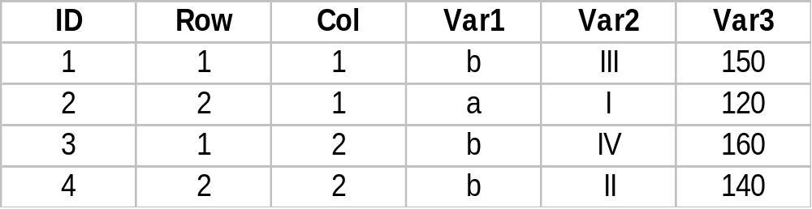
Raster Data Structures
Database Representation
raw data may come in BSQ, BIP, BIL but not good for efficient for GIS processing
Can be represented as standard data base table
joins based on ID as the key field can be used to relate variables in different tables

Slide 17
File Formats for Raster Spatial Data
The generic raster data model is actually implemented in several different computer file formats:
GRID is ESRI’s proprietary format for storing and processing raster data
Standard industry formats for image data such as JPEG, TIFF and MrSid formats can be used to display raster data, but not for analysis (must convert to GRID)
Georeferencing information required to display images with mapped vector data (will be discussed later in course)
  Requires an accompanying “world” file which provides locational information
Image I mage File World File
TIFF image.tif image.tfw
Bitmap image.bmp image.bpw
BIL image.bil image.blw
JPEG image.jpg image.jpw
Although not commonly encountered, a “geotiff’ is a single file which incorporates both the image and the “world” information is a single file.

Slide 18
Vector Data Model
Representing Data using the Vector Model: formal application
.
point (node): 0-dimension
  single x,y coordinate pair
  zero area
  tree, oil well, label location
line (arc): 1-dimension
  two (or more) connected x,y coordinates
  road, stream
polygon : 2-dimensions
  four or more ordered and connected x,y coordinates
  first and last x,y pairs are the same
  encloses an area
  census tracts, county, lake
2
y=2
2
Point: 7,2
1
x=7
1
1
7
7
8
8
2
1
Line: 7,2 8,1
7
8
2
Polygon: 7,2 8,1 7,1 7,2
1
7
8

Slide 19
Vector Data Structures:
Whole Polygon
Whole Polygon (boundary structure): polygons described by listing coordinates of points in order as you ‘walk around’ the outside boundary of the polygon.
  all data stored in one file
    could also store--inefficiently--attribute data for polygon in same file
  coordinates/borders for adjacent polygons stored twice;
    may not be same, resulting in slivers (gaps), or overlap
    how assure that both updated?
  all lines are ‘double’ (except for those on the outside periphery)
  no topological information about polygons
    which are adjacent and have common boundary?
    how relate different geographies? e.g. zip codes and tracts?
  used by the first computer mapping program, SYMAP, in late ‘60s
  adopted by SAS/GRAPH and many business thematic mapping programs.
Topology --knowledge about relative spatial positioning
--managing data cognizant of shared geometry
Topography --the form of the land surface, in particular, its elevation

Slide 20
Whole Polygon: illustration
Data File
A 3 4
A 4 4
A 4 2
A 3 2
A 3 4
B 4 4
B 5 4
B 5 2
B 4 2
B 4 4
C 3 2
C 4 2
C 4 0
C 3 0
C 3 2
D 4 2
D 5 2
D 5 0
D 4 0
D 4 2
E 1 5
E 5 5
E 5 4
E 3 4
E 3 0
E 1 0
E 1 5
5
4
3
A
B
E
2
1
C
D
0
1 2 3 4 5

Slide 21
Vector Data Structures:
Points & Polygons
Points and Polygons: polygons described by listing ID numbers of points in order as you ‘walk around the outside boundary’; a second file lists all points and their coordinates.
  solves the duplicate coordinate/double border problem
  lines can be handled similar to polygons (list of IDs) , but how handle networks?
  still no topological information
  first used by CALFORM, the second generation mapping package, from the Laboratory for Computer Graphics and Spatial Analysis at Harvard in early ‘70s

Slide 22
Points and Polygons:
Illustration
Points File
1 3 4
2 4 4
3 4 2
4 3 2
5 5 4
6 5 2
7 5 0
8 4 0
9 3 0
10 1 0
11 1 5
12 5 5
Polygons File
12
A 1, 2, 3, 4, 1
B 2, 5, 6, 3, 2
C 4, 3, 8, 9, 4
D 3, 6, 7, 8, 3
E 11, 12, 5, 1, 9, 10, 11
5
11
2
1
5
4
3
A
B
E
4
3
2
6
C
D
1
10
9
8
0
7
1 2 3 4 5

Slide 23
Vector Data Structure: Node/Arc/Polygon Topology
Comprises 3 topological components which permit relationships between all spatial elements to be defined (note: does not imply inclusion of attribute data)
ARC-node topology:
  defines relations between points, by specifying which are connected to form arcs
  defines relationships between arcs (lines), by specifying which arcs are connected to form routes and networks
Polygon-Arc Topology
  defines polygons (areas) by specifying
  which arcs comprise their boundary
Left-Right Topology
  defines relationships between polygons (and thus all areas) by
    defining from-nodes and to-nodes, which permit
    left polygon and right polygon to be specified
    ( also left side and right side arc characteristics)
from
Left
Right
to

Slide 24
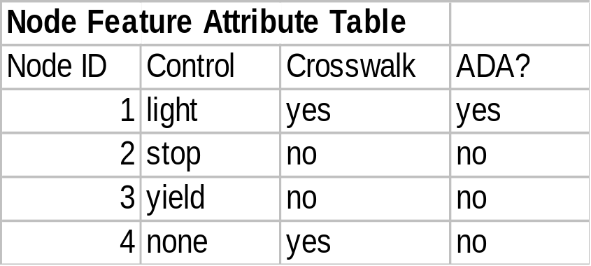
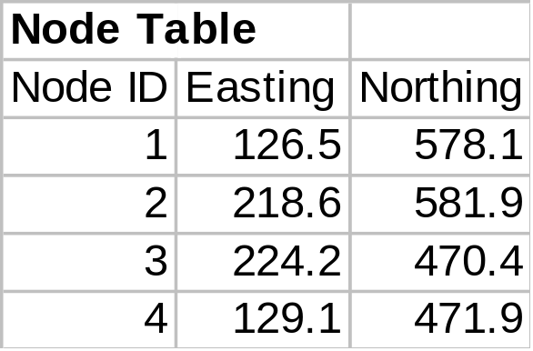
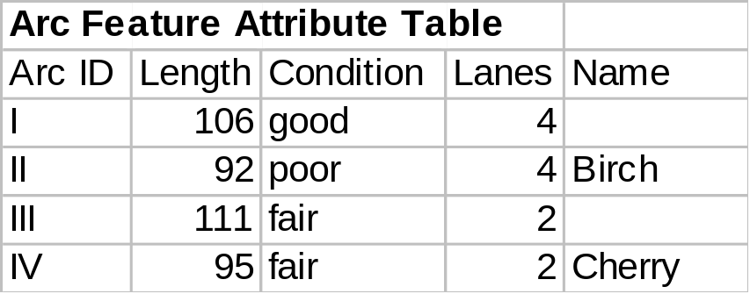
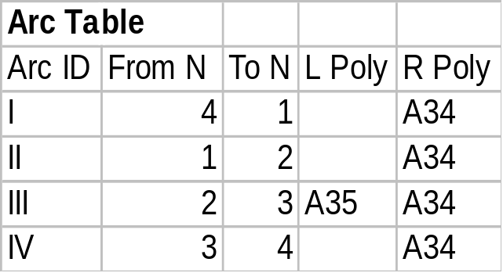
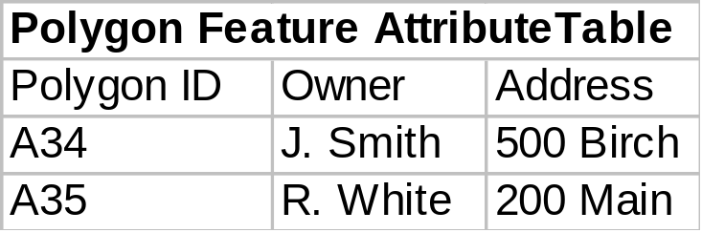
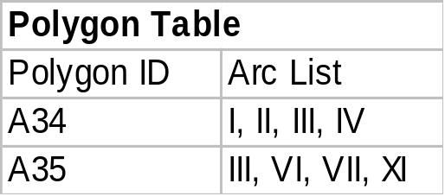
1
II
2
Birch
Node/Arc/ Polygon and Attribute Data
Relational Representation: DBMS required!
I
Smith
Estate
A34
III
A35
4
IV
3
Cherry
Attribute Data
Spatial Data

Slide 25
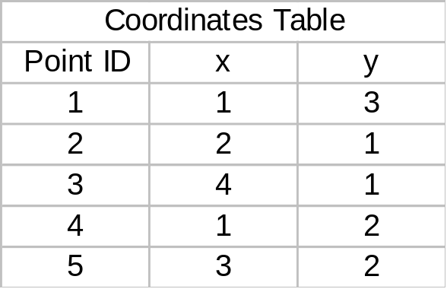
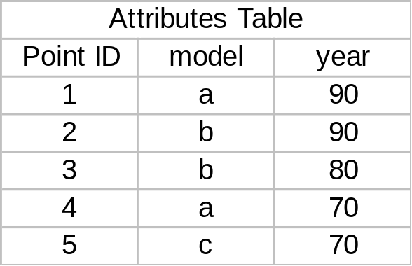
Representing Point Data using the Vector Model: data implementation
Features in the theme (coverage) have unique identifiers--point ID, polygon ID, arc ID, etc
common identifiers provide link to:
  coordinates table (for ‘where)
  attributes table (for what)
Y
1
5
4
2
3
X
Again, concepts are those of a relational data base, which is really a prerequisite for the vector model

Slide 26
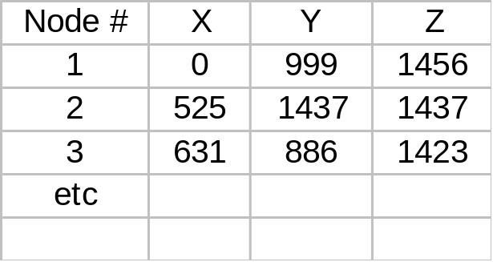
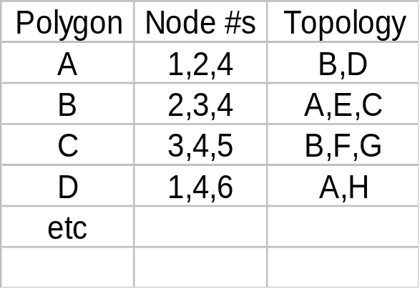
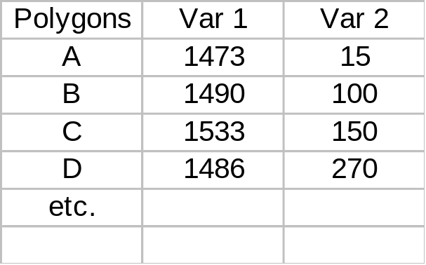
TIN: Triangulated Irregular Network Surface
Points
Polygons
Attribute Info. Database
Elevation points (nodes) chosen based on relief complexity, and then their 3-D location (x,y,z) determined.
Elevation points connected to form a set of triangular polygons; these then represented in a vector structure.
Attribute data associated via relational DBMS (e.g. slope, aspect, soils, etc.)
2
1
E
A
B
3
Advantages over raster:
fewer points
captures discontinuities (e.g ridges)
slope and aspect easily recorded
Disadvans.: Relating to other polygons for map overlay is compute intensive (many polygons)
D
4
C
F
G
5
6
H

Slide 27
File Formats for Vector Spatial Data
Generic models above are implemented by software vendors in specific computer file formats
Coverage: vector data format introduced with ArcInfo in 1981
multiple physical files (12 or so) in a folder
proprietary: no published specs & ArcInfo required for changes
Shape ‘file’: vector data format introduced with ArcView in 1993
comprises several (at least 3) physical disk files (with extension of .shp, .shx, .dbf), all of which must be present
openly published specs so other vendors can create shape files
Geodatabase: new format introduced with ArcGIS 8.0 in 2000
Multiple layers saved in a singe .mdb (MS Access-like) file
Proprietary, “next generation” spatial data file format
Shapefiles are the simplest and most commonly used format and will generally be used in the class exercises.

Slide 28
Geographic Data: Another Perspective
Object View
The real world is a series of entities located in space.
An object is a digital representation of an entity, with three types
    Point objects
    Line objects
    Area objects
  The same entity can be represented at different scales by different object types:
  multi-representation
  Behavior can be associated with objects thus they can change over time
Field View
The real world has properties which vary continuously over space; every place has a value
  May be represented as raster data, or with vector data as a TIN (triangulated irregular network
Field or Object?
If the field value is a categorical or integer variable, then places with the same value (e.g. crop type) can be grouped---into area objects?!
1
1
1
1
1
4
4
5
5
5
1
corn
1
1
1
1
4
4
5
5
5
1
1
1
1
1
fruit
4
4
5
5
5
1
1
1
1
1
4
4
5
5
5
1
1
1
1
1
4
4
5
5
5
2
2
2
2
2
2
2
3
3
3
wheat
clover
2
2
2
2
2
2
2
3
3
3
2
2
2
2
2
2
2
3
3
3
2
2
4
4
2
2
2
3
3
3
2
2
fruit
4
4
2
2
2
3
3
3
The world is how we decide to look at it!!!
From O’Sullivan and Unwin Geographic Information Analysis, Wiley, 2003
Useful perspective since it parallels object oriented concepts in software technology.

Slide 29
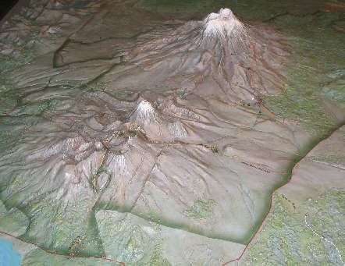

Tongariro National Park
North Island
New Zealand
Representing Surfaces

Slide 30
Overview: Representing Surfaces
Surfaces involve a third elevation value (z) in addition to the x,y horizontal values
Surfaces are complex to represent since there are an infinite number of potential points to model
Three (or four) alternative digital terrain model
approaches available
  Raster-based digital elevation model
    Regular spaced set of elevation points (z-values)
  Vector based triangulated irregular networks
    Irregular triangles with elevations at the three corners
  Vector-based contour lines
    Lines joining points of equal elevation, at a specified interval
  Massed points and breaklines
    The raw data from which one of the other three is derived
    Massed points: Any set of regular or irregularly spaced point elevations
    Breaklines: point elevations along a line of significant change in slope (valley floor, ridge crest)
z
x
y

Slide 31
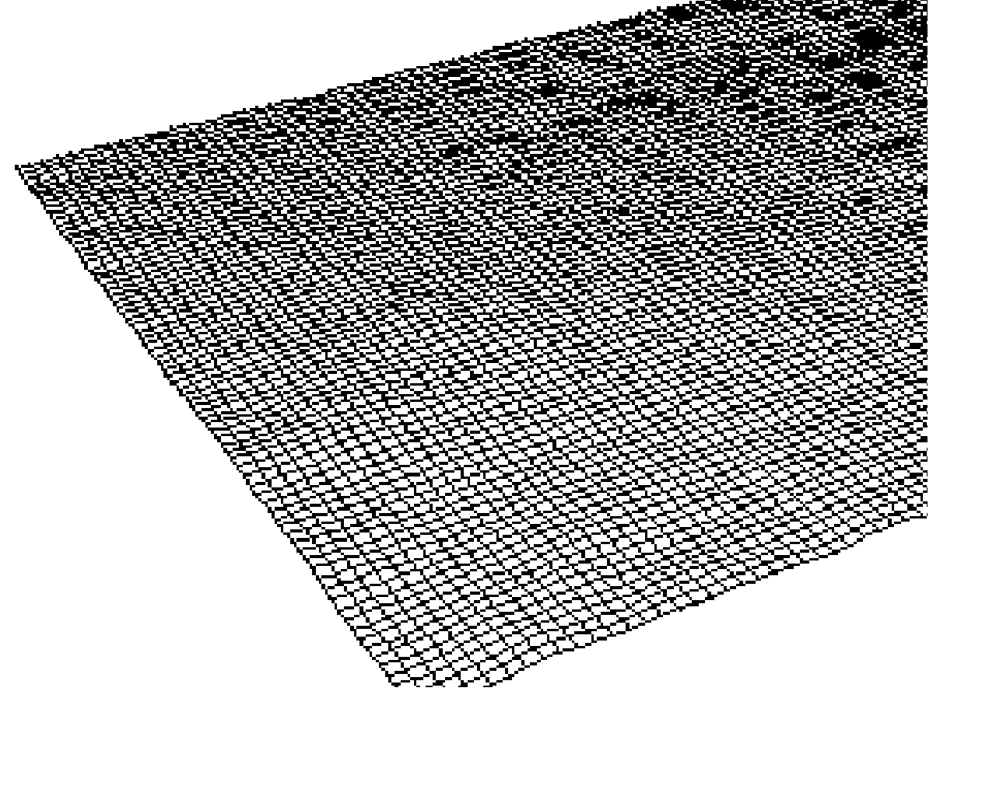
Digital Elevation Model
a sampled array of elevations (z) that are at regularly spaced intervals in the x and y directions.
two approaches for determining the surface z value of a location between sample points.
  In a lattice, each mesh point represents a value on the surface only at the center of the grid cell. The z-value is approximated by interpolation between adjacent sample points; it does not imply an area of constant value.
  A surface grid considers each sample as a square cell with a constant surface value.
Advantages
Simple conceptual model
Data cheap to obtain
Easy to relate to other raster data
Irregularly spaced set of points can be converted to regular spacing by interpolation
Disadvantages
Does not conform to variability of the terrain
Linear features not well represented

Slide 32
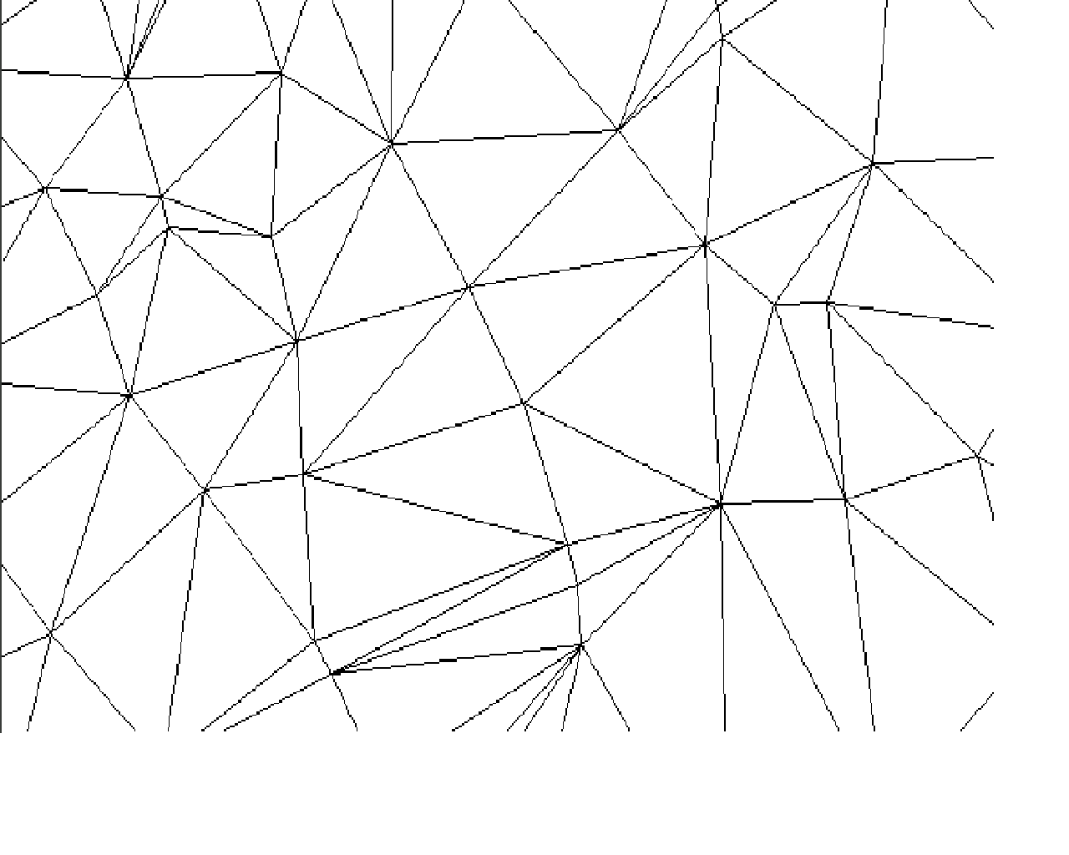
Triangulated Irregular Network
a set of adjacent, non-overlapping triangles computed from irregularly spaced points, with x, y horizontal coordinates and z vertical elevations.
Advantages
  Can capture significant slope features (ridges, etc)
  Efficient since require few triangles in flat areas
  Easy for certain analyses: slope, aspect, volume
Disadvantages
  Analysis involving comparison with other layers difficult

Slide 33
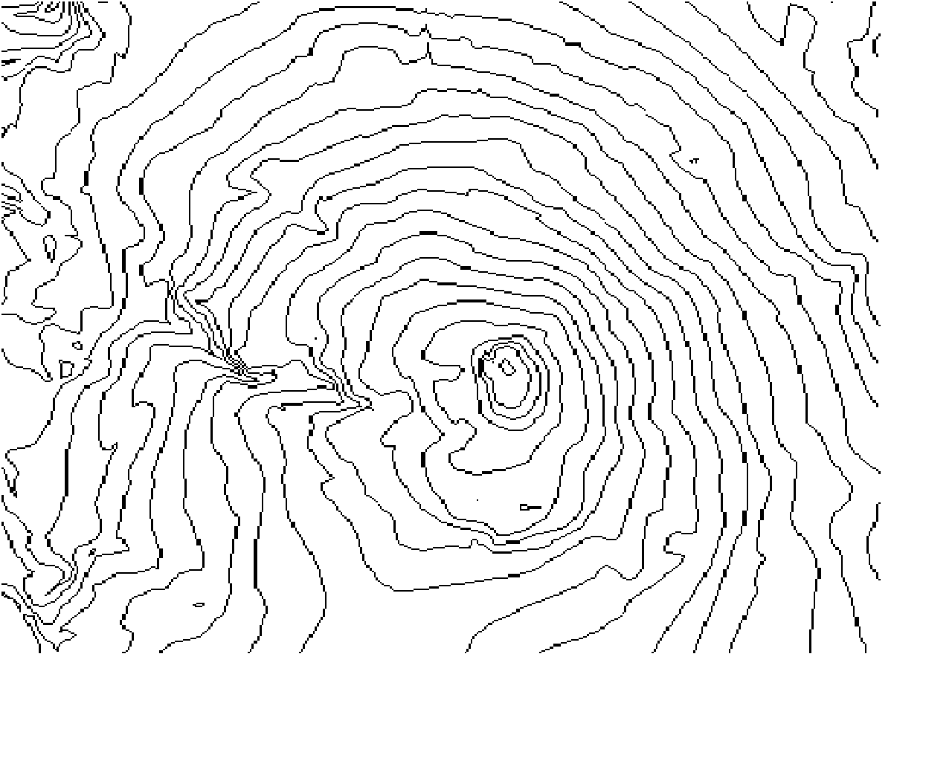
Contour (isolines) Lines
Advantages
Familiar to many people
Easy to obtain mental picture of surface
  Close lines = steep slope
  Uphill V = stream
  Downhill V or bulge = ridge
  Circle = hill top or basin
Disadvantages
Poor for computer representation: no formal digital model
Must convert to raster or TIN for analysis
Contour generation from point data requires sophisticated interpolation routines, often with specialized software such as Surfer from Golden Software, Inc., or ArcGIS Spatial Analyst extension
Contour lines, or isolines, of constant elevation at a specified interval,
valley
hilltop
ridge

Slide 34
Appendix
GIS File Formats
Some additional detail

Slide 35
Vendor Implementation of GIS Data Structures: file formats
Raster, vector, TIN, etc. are generic models for representing spatial information in digital form
GIS vendors implement these models in file formats or structures which may be
  Proprietary: useable only with that vendor’s software (e.g. ESRI coverage)
  Published: specifications available for use by any vendor (e.g ESRI shapefile, or the military vpf format)
  Transfer formats: intended only for transfer of data
    Between different vendor’s systems (e.g. AutoCAD .dxf format, or SDTS)
    between different users of same vendors’ software (e.g. ESRI’s E00 format for coverages)
One GIS vendor may be able to read another file format:
  By translation, whereby format is converted externally to vendors own format
    Usually requires user to carry out conversion prior to use of data
  On-the-fly, whereby conversion is accomplished internally and “automatically”
    No user action needed, but usually no ability to change data
  Natively, or transparently, which normally implies
    No special user action needed
    ability to read and write (change or edit) the data
best

Slide 36
Common GIS & CAD File Formats
ESRI
  Coverages (vector--proprietary)
  E00 (“E-zero-zero”) for coverage exchange between ESRI users
  Shapefiles (vector--published) .shp
  Geodatabase (proprietary) .gdb
    Based on current object-oriented software technology
  GRID (raster)
AutoCAD
  AutoCAD .DWG (native)
  AutoCAD .DXF for digital file exchange
Intergraph/Bentley
  Bentley MicroStation .DGN
  Intergraph/Bentley .MGE
Spatial Data Transfer Standard (SDTS)
  US federal standard for transfer of data
  Federal agencies legally required to conform
  embraces the philosophy of self-contained transfers, i.e. spatial data, attribute, georeferencing, data quality report, data dictionary, and other supporting metadata all included
  Not widely adopted ‘cos of competitive pressures, and complexity and perceived disutility derived from philosophy

Slide 37
ESRI Vector File Formats: “Georelational”
Shape ‘file’: native GIS data structure for a vector layer in ArcView
not fully topological
  limited info about relationship of features one to another
  draw faster
  not as good for some fancy spatial analyses
is a ‘logical’ file which comprises several (at least 3) physical disk files, all of which must be present for AV to read the theme
  layer.shp (geometric shape described by XY coords)
  layer.shx (indices to improve performance)
  layer.dbf (contains associated attribute data)
  layer.sbn layer.sbx
not really a database, although ArcView presents files to user via relational concepts
openly published specs so other vendors
can develop shape files and read them
Coverage: native GIS data structure for a vector layer in ArcInfo
fully topological
  better suited for large data sets
  better suited for fancy spatial analyses
comprises multiple physical files
(12 or so) per coverage
  each coverage saved in a separate folder named same as the coverage
  physical file set differs depending on type of coverage (point, line, polygon).
  coverage folders stored in a “workspace” directory with an info folder for tracking
  attribute tables stored there also
ARC/INFO required to make changes
proprietary: no published specs.
E00 Export Files: format for export of coverages to other ESRI users
IMPORT71 utility in ArcView Start Menu can read E00 files and convert them back to coverages
Must convert to shapefile or AutoCAD .dxf format to transfer to a non-ESRI GIS system

Slide 38
ArcGIS 8
Database Environment
II. Geodatabase
The new term with ArcInfo 8 in 2000
Replacement for coverages, and support for
Simple features: points, lines polygons
Complex features: real world entities modeled as objects with properties, behavior, rules, & relationships
AV downgrades complex features to simple features
Personal Geodatabase
Single-user editing
Stored as one .mdb file (but Access can’t read)
AV 3.2 cannot read (to be “fixed” later)
Multiuser Geodatabase
Supports versioning and long transactions
Uses ArcSDE 8 as middleware
Stores in standard db: ORACLE, MS SQL Server, Informix, Sybase, IBM DB2
AV3.2 can read
I. Geo-relational Database
the old “classic” environment
proprietary coverages in ArcInfo (INFO database)
published shapefiles in ArcView (dbIV database)
Based on points, lines, polygon model

Slide 39
ArcGIS Raster File Formats
Image files: raster supported in several formats:
BSQ, BIL, BIP and run length comp.
JPEG (must load JPEG image extension)
TIFF (must license a dll if LZW comp. used)
ERDAS GIS, LAN, IMAGINE
Georeferencing information required if images to be displayed with mapped vector data
  cells of the raster must be converted to the XY coordinate metric (lat/long, projected feet etc.) of the map
  stored in header file of the raster image (e.g. GEOTIFF) or in a separate “world” file
Image Image File World File
TIFF image.tif image.tfw
Bitmap image.bmp image.bpw
BIL image.bil image.blw
Be sure you have both files!
GRID:
native proprietary format for a raster file in Arc/Info
incorporates positioning info.
can be read by ArcView
all raster-based analyses require files in GRID format, including ArcView Spatial 3-D Analyst
ArcView has some limited capabilities for converting to GRID format, but generally this requires ARC/INFO ( or the PC-based Data Automation Kit)
when ArcView saves GRID data sets it does so in an ARC/INFO-style format: ArcCatalog must be used to manage these

Slide 40
Spatial Database Engine (SDE)
ESRI “middleware” product designed to interface with industry-standard RDBMS for large scale spatial data bases
First introduced with ArcInfo Version 7 in the mid 1990s;
ArcView version 3.0 and later can read SDE
both attribute and spatial data is stored in the same RDBMS (such as Oracle, which supports SDE)
allows mass data capabilities, security and data integrity mechanisms of the RDBMS to be applied to the spatial data
data is grouped into:
  sets, which share common security (e.g. all data for a city)
  layers, similar to themes (e.g. road layer, parcel layer)
  features, individual elements (e.g. single road)
advantages for large data sets include
  layers are not tiled, so no re-assembly is required
  features can be extracted as a complete element e.g. entire road
Arcinfo/arcview
sde
rdbms

